Slide 1

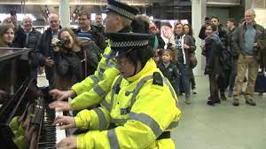
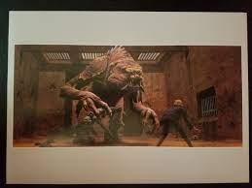
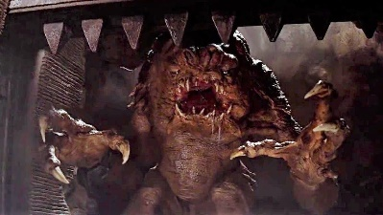
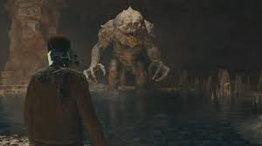

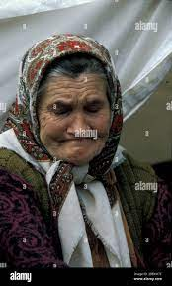
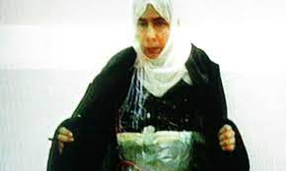
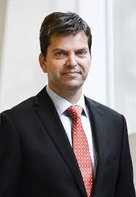
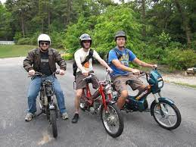

FBI
partner
development
CPVA.§187.PREA ibm.dos
MONOPOLIES
OLMYPICS
INTERNET
FBI:TERROSIM Irish . St. Anlsm visa
St. Nick
star wars rancor boss fight
41.David and Gloath
LEVEL: davut G.VIRING.MARY phil/kim
!HOMICID:AUSLAER:!HOMCEBILL
WAR IN YUGLSLAVIA
Serpation(25): Haiduk
1998 help me
x
TORT-1
41.§Theft
fulle
1996 88th
ibm
Doner face cum;Melanie;
§123 Breaking and Engers, hasufriendbruch

Slide 2
FBI
partner
development
MAINSTREET(HOMCIDE:FACTORYOWRK).appel.camera
G.VIRGINIA.MAINSTREET( audio Olympics sigh, red G, 5,000)
VIRIGN vw camera; apple network camera;
Parking lot; chaine factory

Slide 3
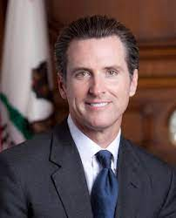
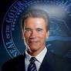

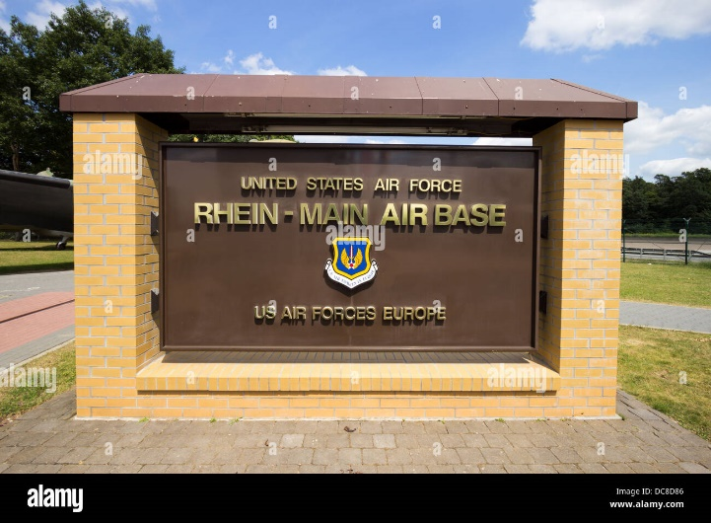
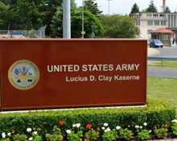

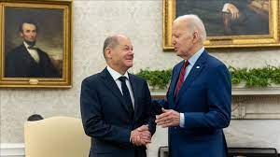
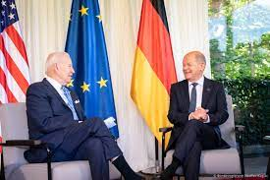
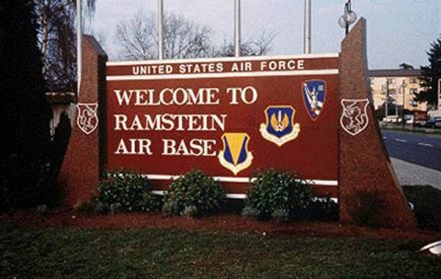
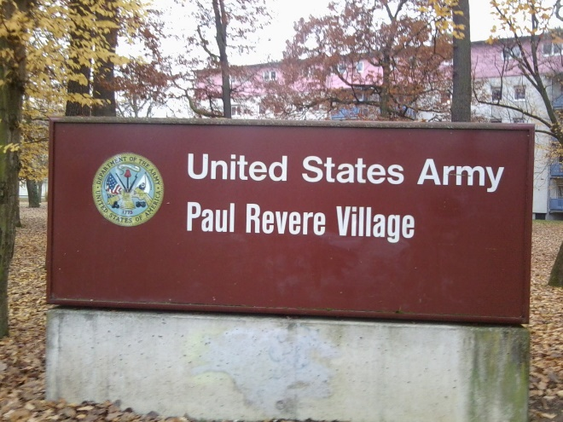

FBI
partner
development
CPVA.§187.PREA ibm.dos
MONOPOLIES
OLMYPICS
INTERNET
!HOMICIDE:AUSLAENER:!HOMCEBILL
FBI:TERROSIM Irish . St. Anlsm visa
St. Anselm
CVPA
St. Francisc.Angle.flea.VIRGINA.MARY
St. Nick
star wars rancor boss fight
41.David and Golath
WW1WWW2.v2.FBI:KIDNAPING.CPVA.§187.PREA
G.
Chart
INCIDENTS
G(person).CPVA.!PRESIDENT.AVAILABILITY
WAR IN YUGLSLAVIA

Slide 4
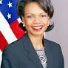
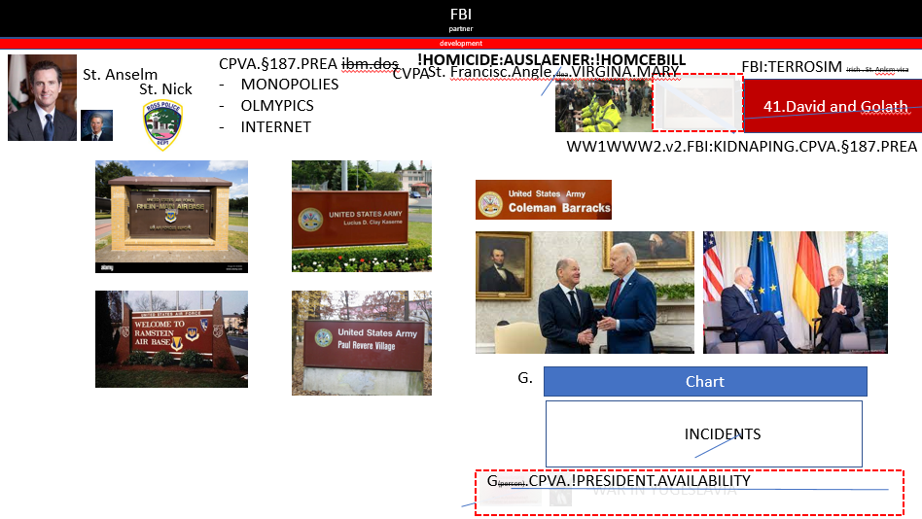
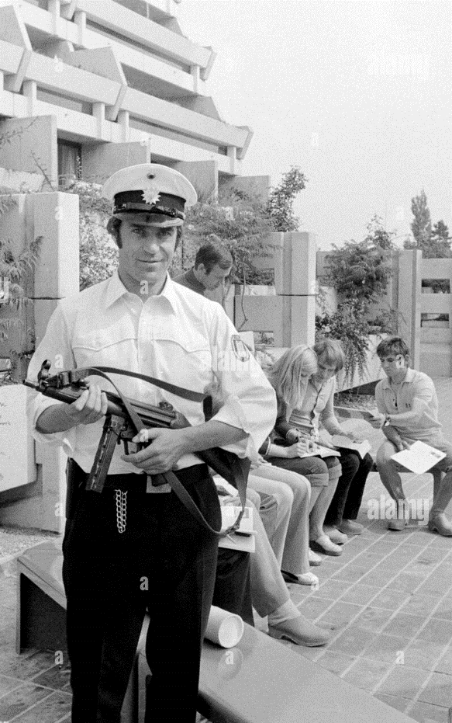
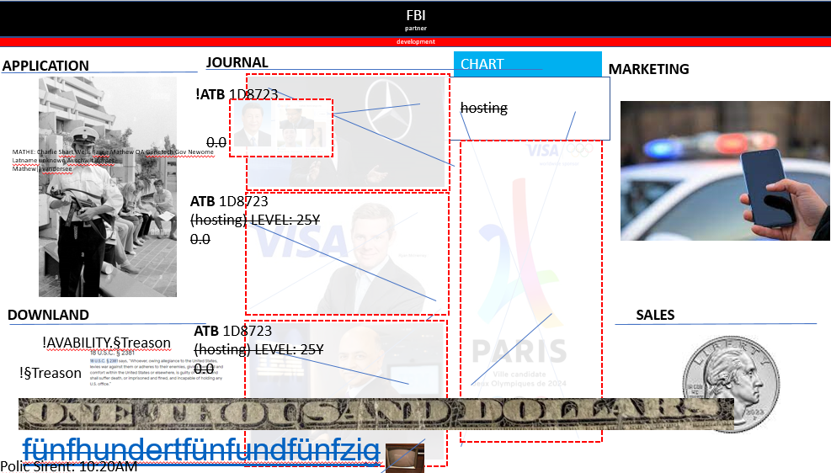
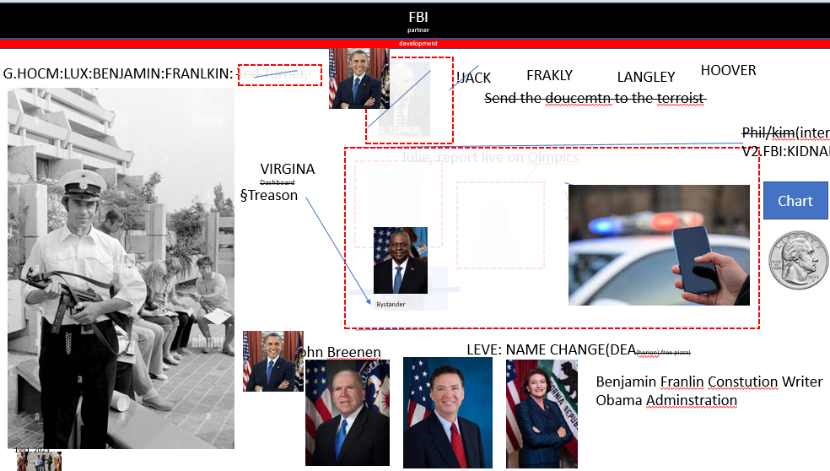
FBI
partner
development
PRESIDENT:AVAILABLITY.JFK(CPVA).MLK(CPVA).v2.FBI:KIDNAPPING
Chart
Chart
Chart
HOMCIDE:BILL:HOMCDIE:AUSLANDER
JFK
V2.FBI:KIDNAPPING
Chart
Chart
Chart
HOMICIE:LUX
KOREAN WAR
INTERUTPS
Phil/kim
Chart
Chart
Chart
FBI:TERRORISM
G.GOT.TV
HOMCDIE
:IS-A-BELL
Olmpics
Chart
DEA

Slide 5
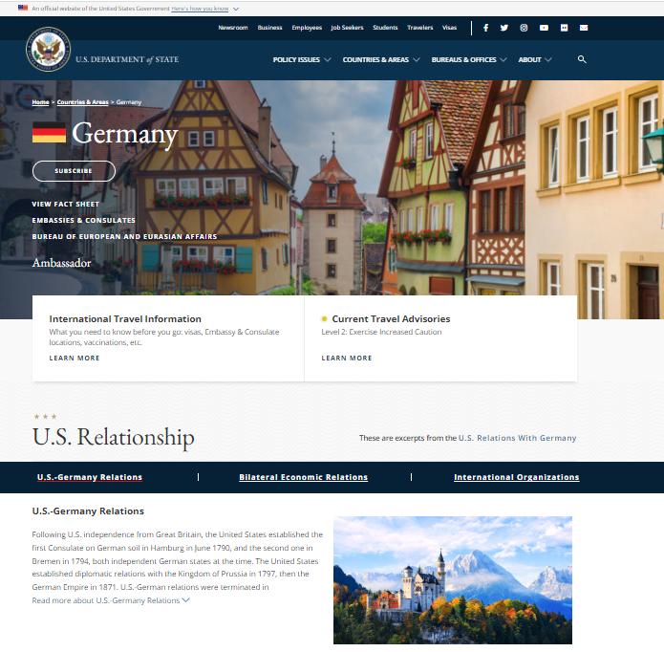
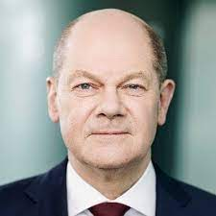
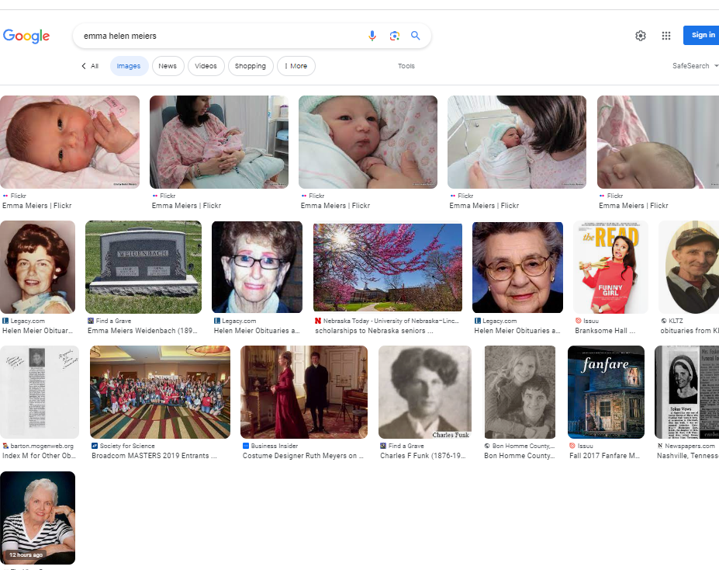
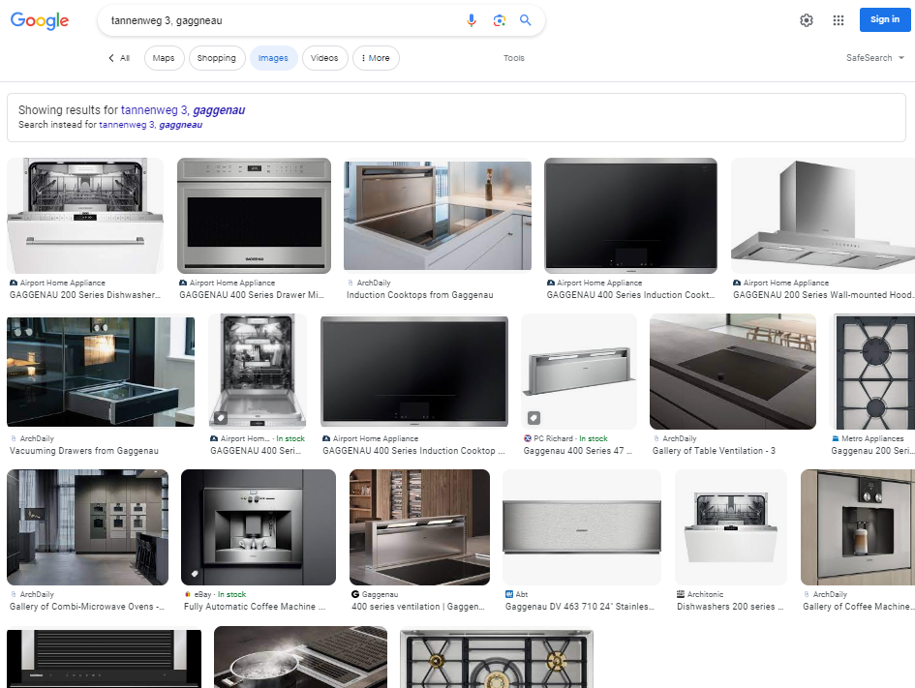
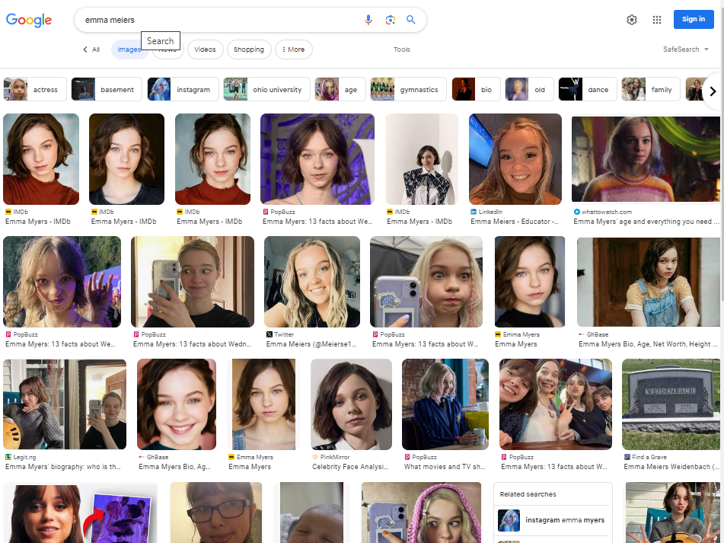
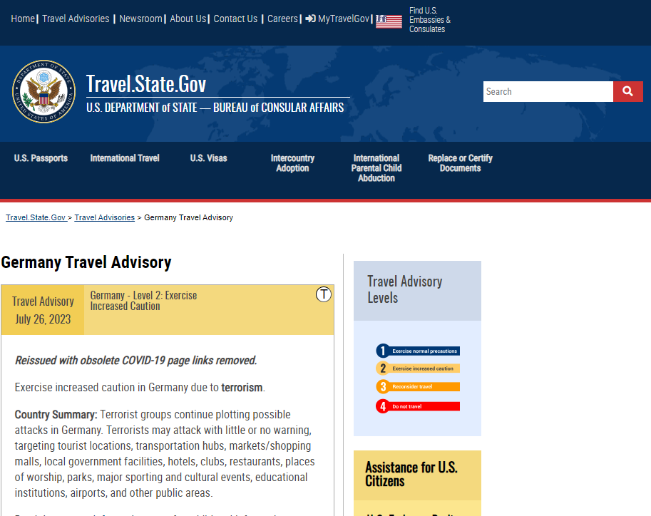

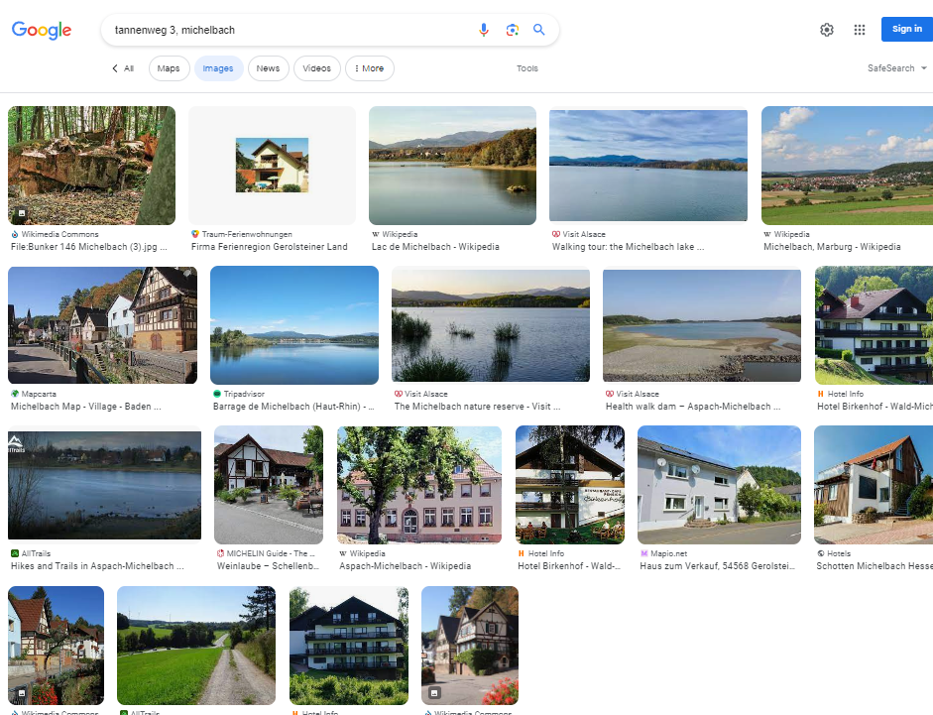
FBI
partner
development
FBI:INTERNATIONAL:TERRORISM
V2.FBI:KIDNAPPING
Address Redhouse
!raik.pine
Assumed: !voted
TERRORISM
GERMANY
LIVE

Slide 6
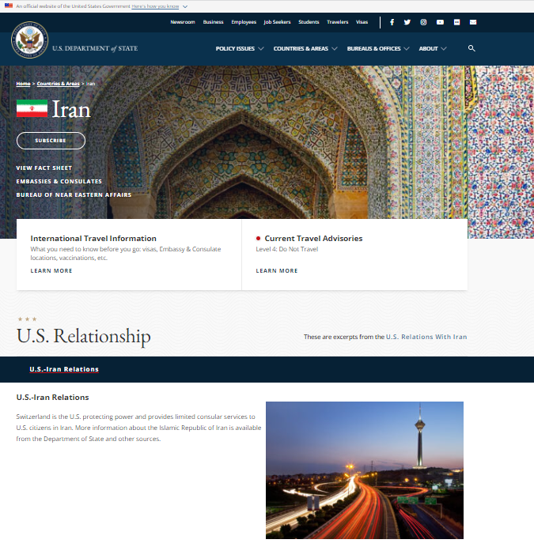
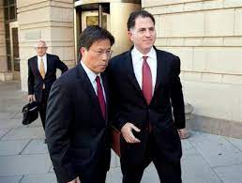

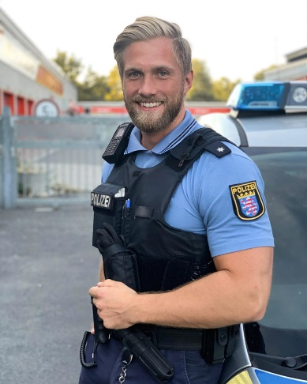

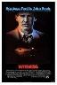

FBI
partner
development
Icc.marx(putin)
Gorbachev(dell)
Paris, 2024
Germany
PENTAGON.emea.deere.St. Andrew Van Scooter: ID:DE->IRAN
September 5th, 1972
2010
Germany
Iran
FRA - IKA
NATO:FBI:WMDMax-Plank !anglea.chalrie
Post Doc: Dr. Firshan and IRan

Slide 7
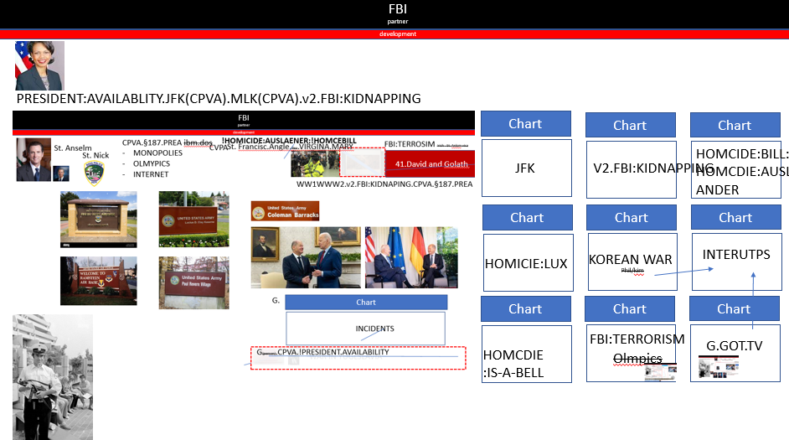
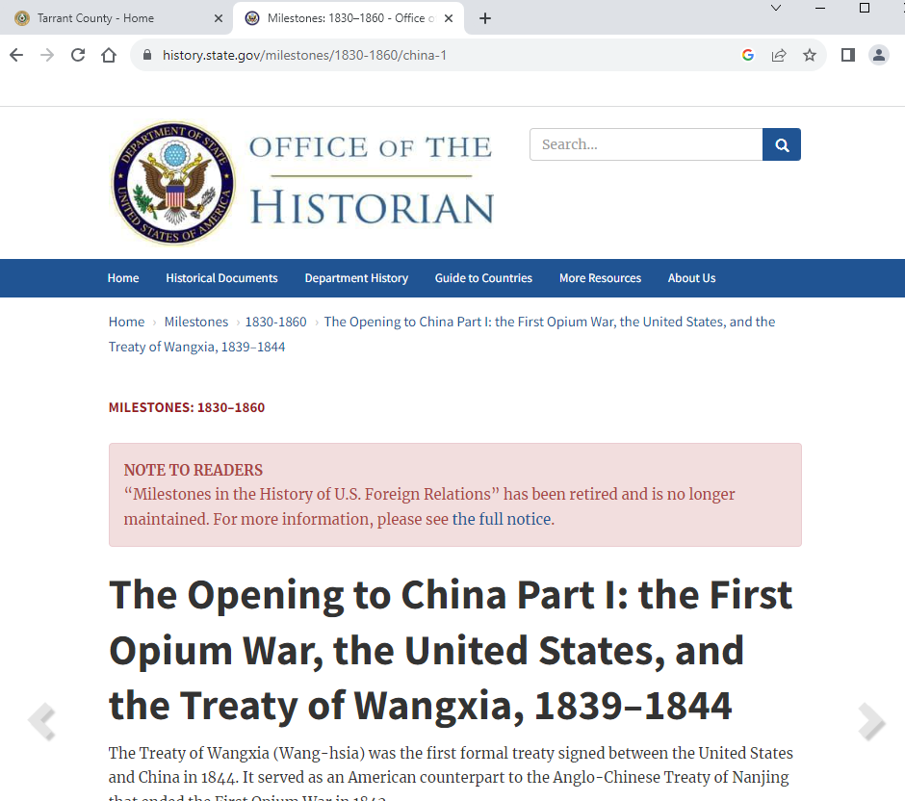
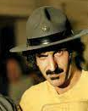
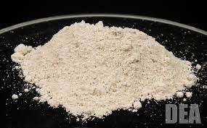
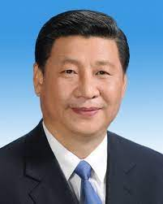


FBI
partner
development
Opium War
The Signing of the Treaty of Nanjing in 1842
Phil/kim.tattoo.
v2.FBI:KIDNAPPING.ghoeh(who is god? (heb.Michaela)
-15 Slides
CPVA.§187.PREA.AMCE CHANGE(“mr free” pizza)
PENGONG.BASE.PAUL.DEA.UNIVERSITY
PETAONG.emailphone.sptheon: heorn untils on table
VP GERMANY manuel
In herion high
VIRING.MARY IVY STANFORD greek mytholy CPVA x/y

Slide 8
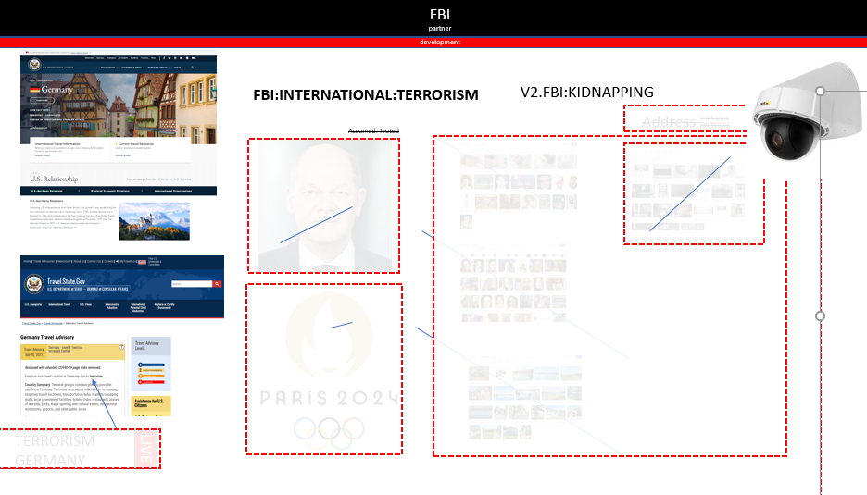

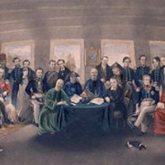
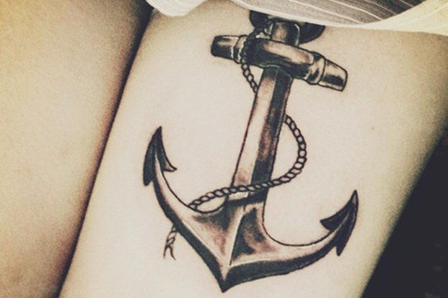


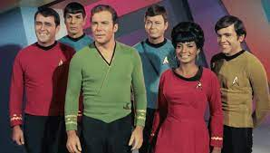
FBI
partner
development
LIVE
2014
Paris 2024
Opium War,
the United States
Comptuer 2023
KING.”Counter”
1 Person – Father Jason Meiers
FORT WORHT – COURT
FORT MYERS
DEA(HERION
NAVY.DEA.level
Chart
WW2.NAVY.DEA.v2:FBI:KDINAPPING
DEA
WWI
HOMICDIE:FAMILY(MATHEW) Xi, Yang CONSTITION.VIOLATIONS
Pecular descriptions; H-O-R-S-E for Heroin
!AVABILAIT.sleep Pleaont Hourse Rache
!HOMCEI:NANA doct.roth.*
1986/7 and 2023
CHART.ATB.!HOMCEI:KYSTAL (docs.roth.*) !HOCME:NANA
nonPoliceNewark

Slide 9
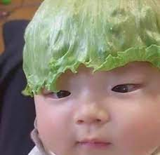

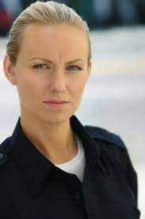


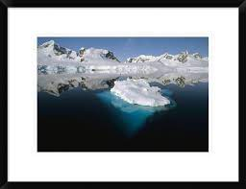
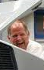
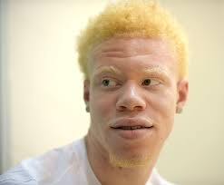
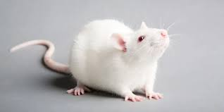




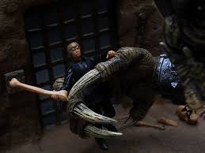
FBI
partner
development
IMPORT ghoeh(drpess)
CONSTITUTION:FBI:FWD:INT
IMPORT
FEDERAL COURT GERAMNY CONSTITUTION
2014 Olypicec Visa Blond Google Dr Jan Auerhammer, Damiler Ag
2014
black
!blond
G.GOT.TV
1995 March - 2023
EXPORT JFK(3-way. Triatholo)
Impigmentation: !black
!JFK(petersson)
Gjoeh(knight)
shame
z
2015
Z-3
IMPORT iron hourse trail
McCARTHY
!In
TORT-2
Young/jung
St. Nick.QA
CPVA
DOCS
Genius
Genetech: benton
McCARTHY
FBI:WMD:DUBLEIN:GREEN
Walk with packege to yang vicent
[x] no
!In
ATOMCLOCIK(ContentItem)
INTERVIEW
000.tw.pns
US DAVIS
DAVID
!In
Yang.vincent
GENSIS
MAINSTREET(WWI.eros; Davut)
CPVA
)

Slide 10
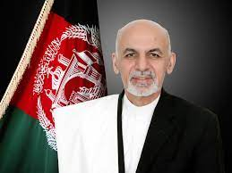
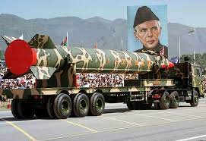






FBI
partner
development
WWI.§ProstsitonLaw
SQ.INT.“Paki”
HOMCI:2Y
ATOMCLOCK(Tim).
LARRY(PX
musican pocelin)
Joyti IPX Joyti CPVA:HOMCID:ITLIAN:20
Pakistan
0.1 gheoh(mika,kinderganr):PETNAOGN.emea
Stefans Girlfreind
Afganstan
Pakistan
HOCM:LUX:HOMIC:STILLBORD §Aborsiton merkel
WAR:HOMCE:STILLBORG

Slide 11




FBI
partner
development
WWI.§ProstsitonLaw
SQ.INT.“Paki”
HOMCI:2Y
ATOMCLOCK(Tim).
LARRY(PX
musican pocelin)
Joyti IPX Joyti CPVA:HOMCID:ITLIAN:20
Pakistan
0.1 gheoh(mika,kinderganr):PETNAOGN.emea
Stefans Girlfreind
Afganstan
Pakistan
HOCM:LUX:HOMIC:STILLBORD §Aborsiton merkel
WAR:HOMCE:STILLBORG
ATOMCLOCK(tim/o,DEA(heioin)
Otto-Hahn-Str
2015
1991
PAUL.HOMCE:LUX:1/4.marx(!polen)
Elke Vagaina
Pre Michelle Brith
Joeoshe
Ear
blond vagana hair pregnet old
Otto-Hahn-Str
?HR

Slide 12














FBI
partner
development
Machine Gun Facoty
Kill tim cook !ivert
CHART
SCHEUDULE
MS-OULOOK
https://bit.ly/1D8723-nonPoliceHomicide-LUX
“Crumbs”
Chart
Try{
}catch( Olmpics(<<fifa>>)
Exception:
Cisco Motnroing Fifa 2014
DEA
1991
!angela.POT
1/4-de-pl.
“shit”
TERRORISM
GERMANY
LIVE
NAME CHANGE(free pizza,DE-LEGISLATION:HOMCEI:LUX)

Slide 13










FBI
partner
development
!In

Slide 14















FBI
partner
development
1997 – 1998 MAINSTREET VIRIGINA.MARY !Thomas-is-dieter:sew
41.Phil/kim
MAINSTREET(WWI.HOME:KYSTAL)
!WINSTON10c
1:15AM
HOMID:IS-A-BELL(10c)
10c
41
2022 - 2023
Us.marx
Us.marx
Joseph DePinto
Us.marx

Slide 15



















FBI
partner
development
2014 CPVA.Scheuduler.WWI.Toosie
Thomas Dieter
Steve
Phil/kim
Thomas-Mann-Str
!phil/kim
Angela.melanie.nees.like.house
1997/8
41.CIVLI CODE, LABOR CODE surfin in brian for Damiler Ag, CPVA
!drunk.cfg
41.Voices
Suring in brian, frauenhoffer
§Bystander
JFK(jacklin, ddre spy riarcdo)
Damier ag
Surf nugget
Suff nackeed
Dnaile kotje High, grandmother chair
!41
IPX JFK(burce, sniffling gas, naked in wheelchair, )

Slide 16















FBI
partner
development
1998 18 March23
CHEKCPOINT CHALRIE(INTERVIEW)
MAINSTREET(SQ.AIRFILED)
G.God.G.angala.elke.se.x
Start
VIRIGNA.MARY
Montoring and coplaing in virigity
1996
1997
CPVA.bier
FDERAL DEFAULT CPVA black
Friday, Saturday
FBI:WMD INT
41.PAUL.phil/kim.”Move Out”.NAMECHNE(free pizza)
Elke: he has money acna move out 1024 DM/ $525
17(Y) from Jan SQ.AIRFILED
POLCI SINET: 2:55PM adlph hiter,evaburn FRIDAY, WEEKEND
Do you want me to suck you dick?
[x] no

Slide 17





FBI
partner
development
MAINSTREET(SQ.AIRFILED.CPVA.PREA.§187).marx
v2.FBI:KIDNAPPING
VIRGINA.MARY[]
.gobahce(who is god? (hebr) Michela
Roth.marx
Dirk,6c
KOCHEMAN Sheep
Roth.marx
Atlatik hoel denise groenitz
denis groenitz
imitat micheal douglas

Slide 18
FBI
partner
development
Icc.marx(putin)
Anglea(ddr
SQ..FEDARL PATEN LAW OFFICE.
Monitoring-As-a-Service™
IBM Winston Chir
2023
Monitoring-As-a-Service™
VIRGINA
Anglea(ddr
2005 Monitoring-on-Demand™
IBM Cloud Monitoring
IBM W/SAM
Anglea(ddr
1990
1980
Goprabhoch(Anglea(ddr)
VIRGINA

Slide 19















FBI
partner
development
Gorbahce(micheal Kupfer(tral copper))
web
March 2010
OFFSITE:
ONSITE:
3x (ghoeh(miechal)
Gorbache(Visa France)
Gorobhe(copper)
Gorbhce(who is god?)
IMPORT Adam apple.touch
IMPORT Adams. Apple.touch
INTERNET
2006/7 San Francisco
ATOMCLOCK
Geneis
SQ.Adam Grocery Store in Larkspur
Adadm Angle Melkle Cornelius Schulttes
JFK(GENSIS(Sega), mothe rsneds old sega)
?HOMCIDE:MATHEW
Andrew Bennte
Genetech QA
Shane Wesley
Danger Bob
Caleb ?
Tim
sharne welsey san francico mangement consusltaint
St. Aselmo.ROTC
Wells Fargo
MONSTATARY.
I have never seen this in my lfe. 25Y germany
27Y his odd hant, there ajiwsh singles
jewish singles 2008
1980 Asusemed St. Anslemo.LANGLEY, Tiberoun, MARIN(Mathew, Caleob)
PAUL: kitchen
Mathew Regan
Tim Tiberon

Slide 20










FBI
partner
development
MONSTATARY

